Slide 1
Cache Memory Management Techniques
Block Placement, Block Identification

Slide 2
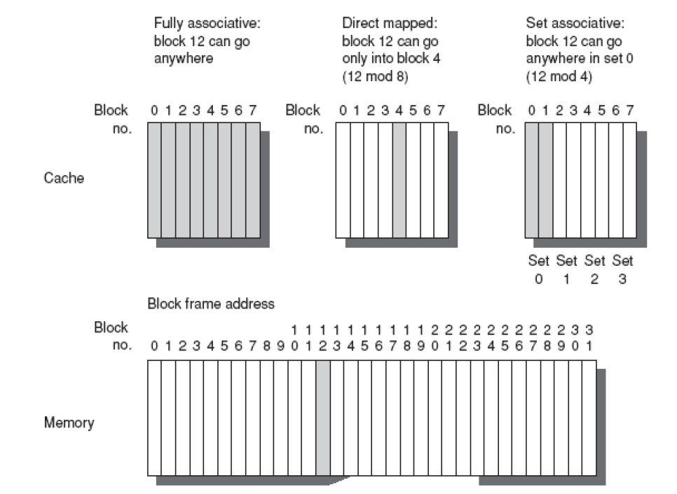
Block Placement

Slide 3
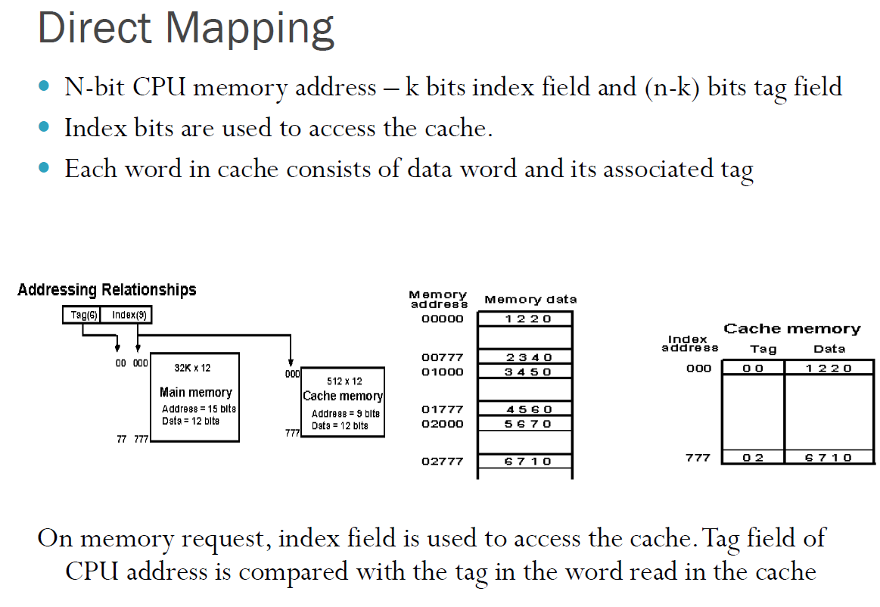
Memory organized into words

Slide 5
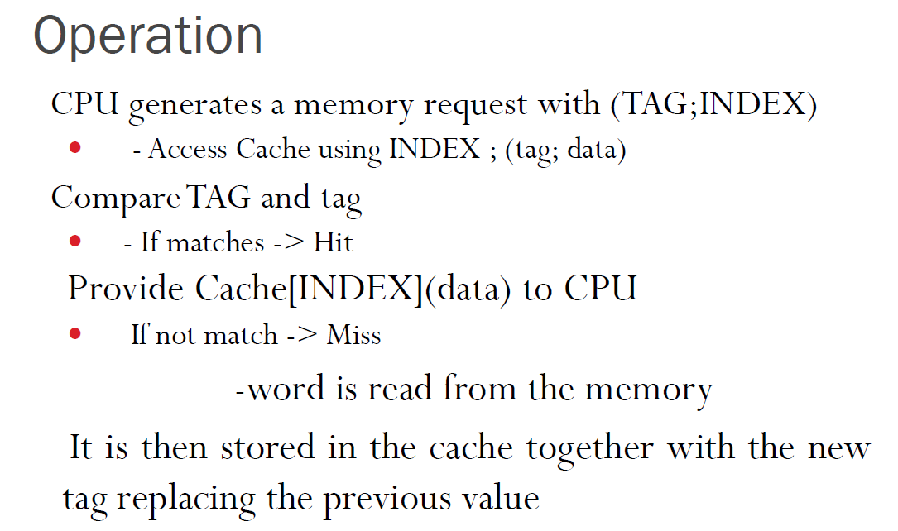

Slide 6
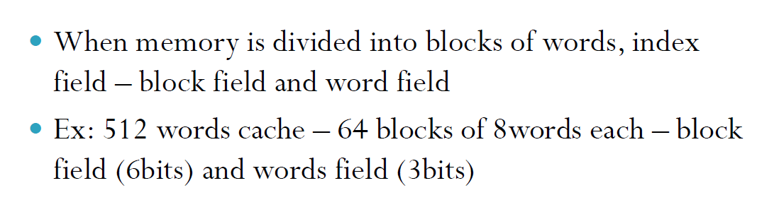

Slide 7
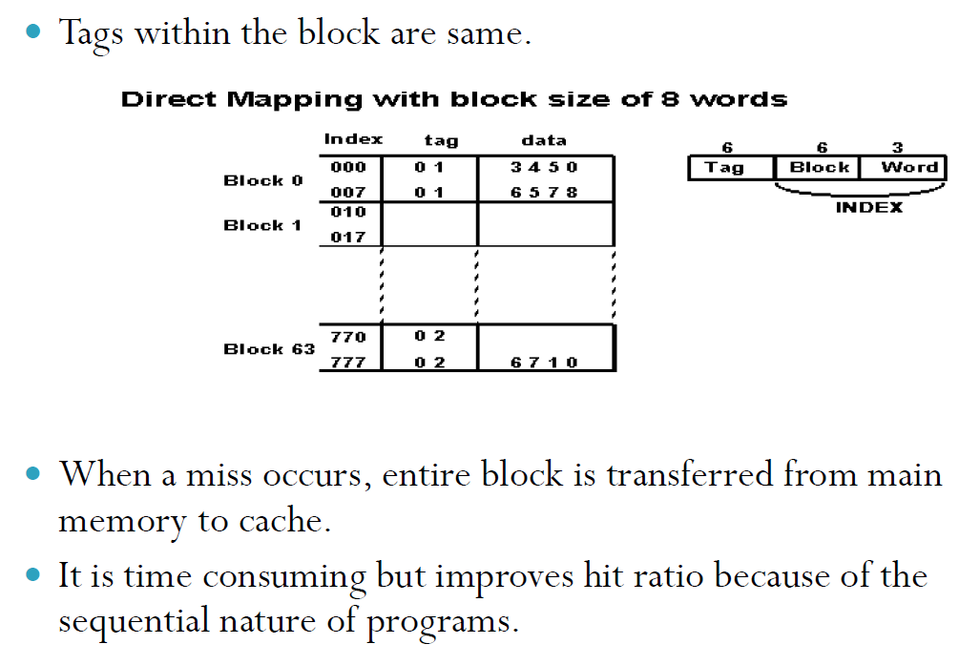

Slide 8
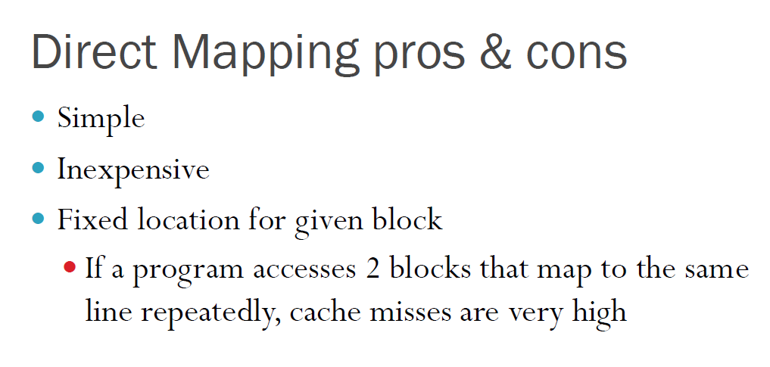

Slide 9
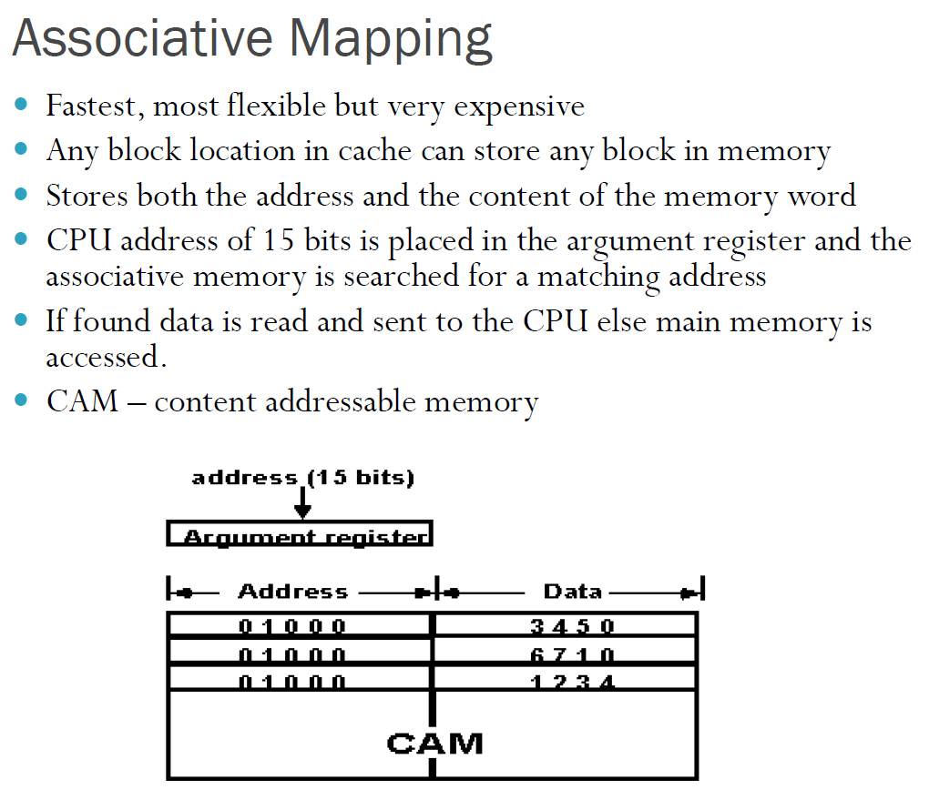

Slide 10
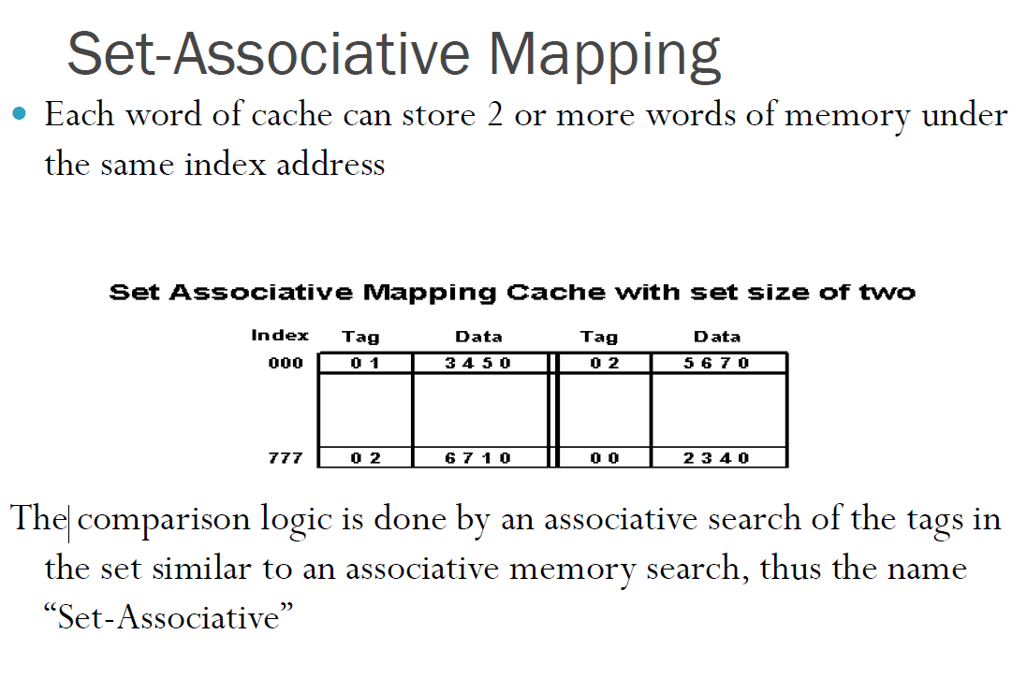

Slide 11
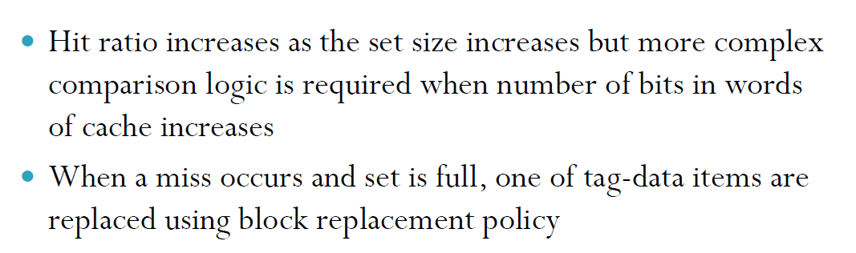

Slide 12
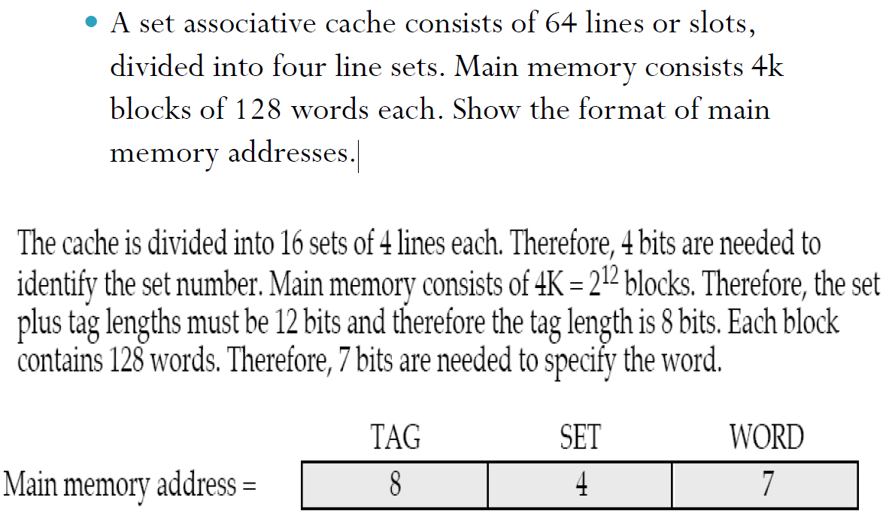
Problem

Slide 13
1. Consider a cache with 32 blocks and 32 bytes per block. Main memory is byte addressable with 32-bit address. Draw and explain about the address formats for the following mapping techniques:
Set Associative mapping (Assume 8-way set associative)
Associative mapping
Direct mapping

Slide 14
Consider a cache with 32 blocks and 32 bytes per block. Main memory is byte addressable with 32-bit address.
Cache lines m = 32 = 2⁵
Block size 2^{k} = 32
Main memory size = 2³²
Blocks in Main memory = 2³²/2⁵ = 2²⁷
Addresses for Direct Mapping:
Block = 5 Word = 5 bits
Tag = 27-5 = 22 bits
Addresses for Associative Mapping
Each cache line address part – 27bit block address + 5 bit word address
Addresses for Set Associative Mapping
8 way set associative => Number of blocks per set = 8
Number of sets in cache: Number of blocks in cache / 8 = 4 sets
Set= 2
Word= 5
Tag= 32-7 = 25

